Slide 1
Usability Testing & Prototyping Final Project
WEB170 – Web graphics and prototyping
Giselle Njaastad

Slide 2
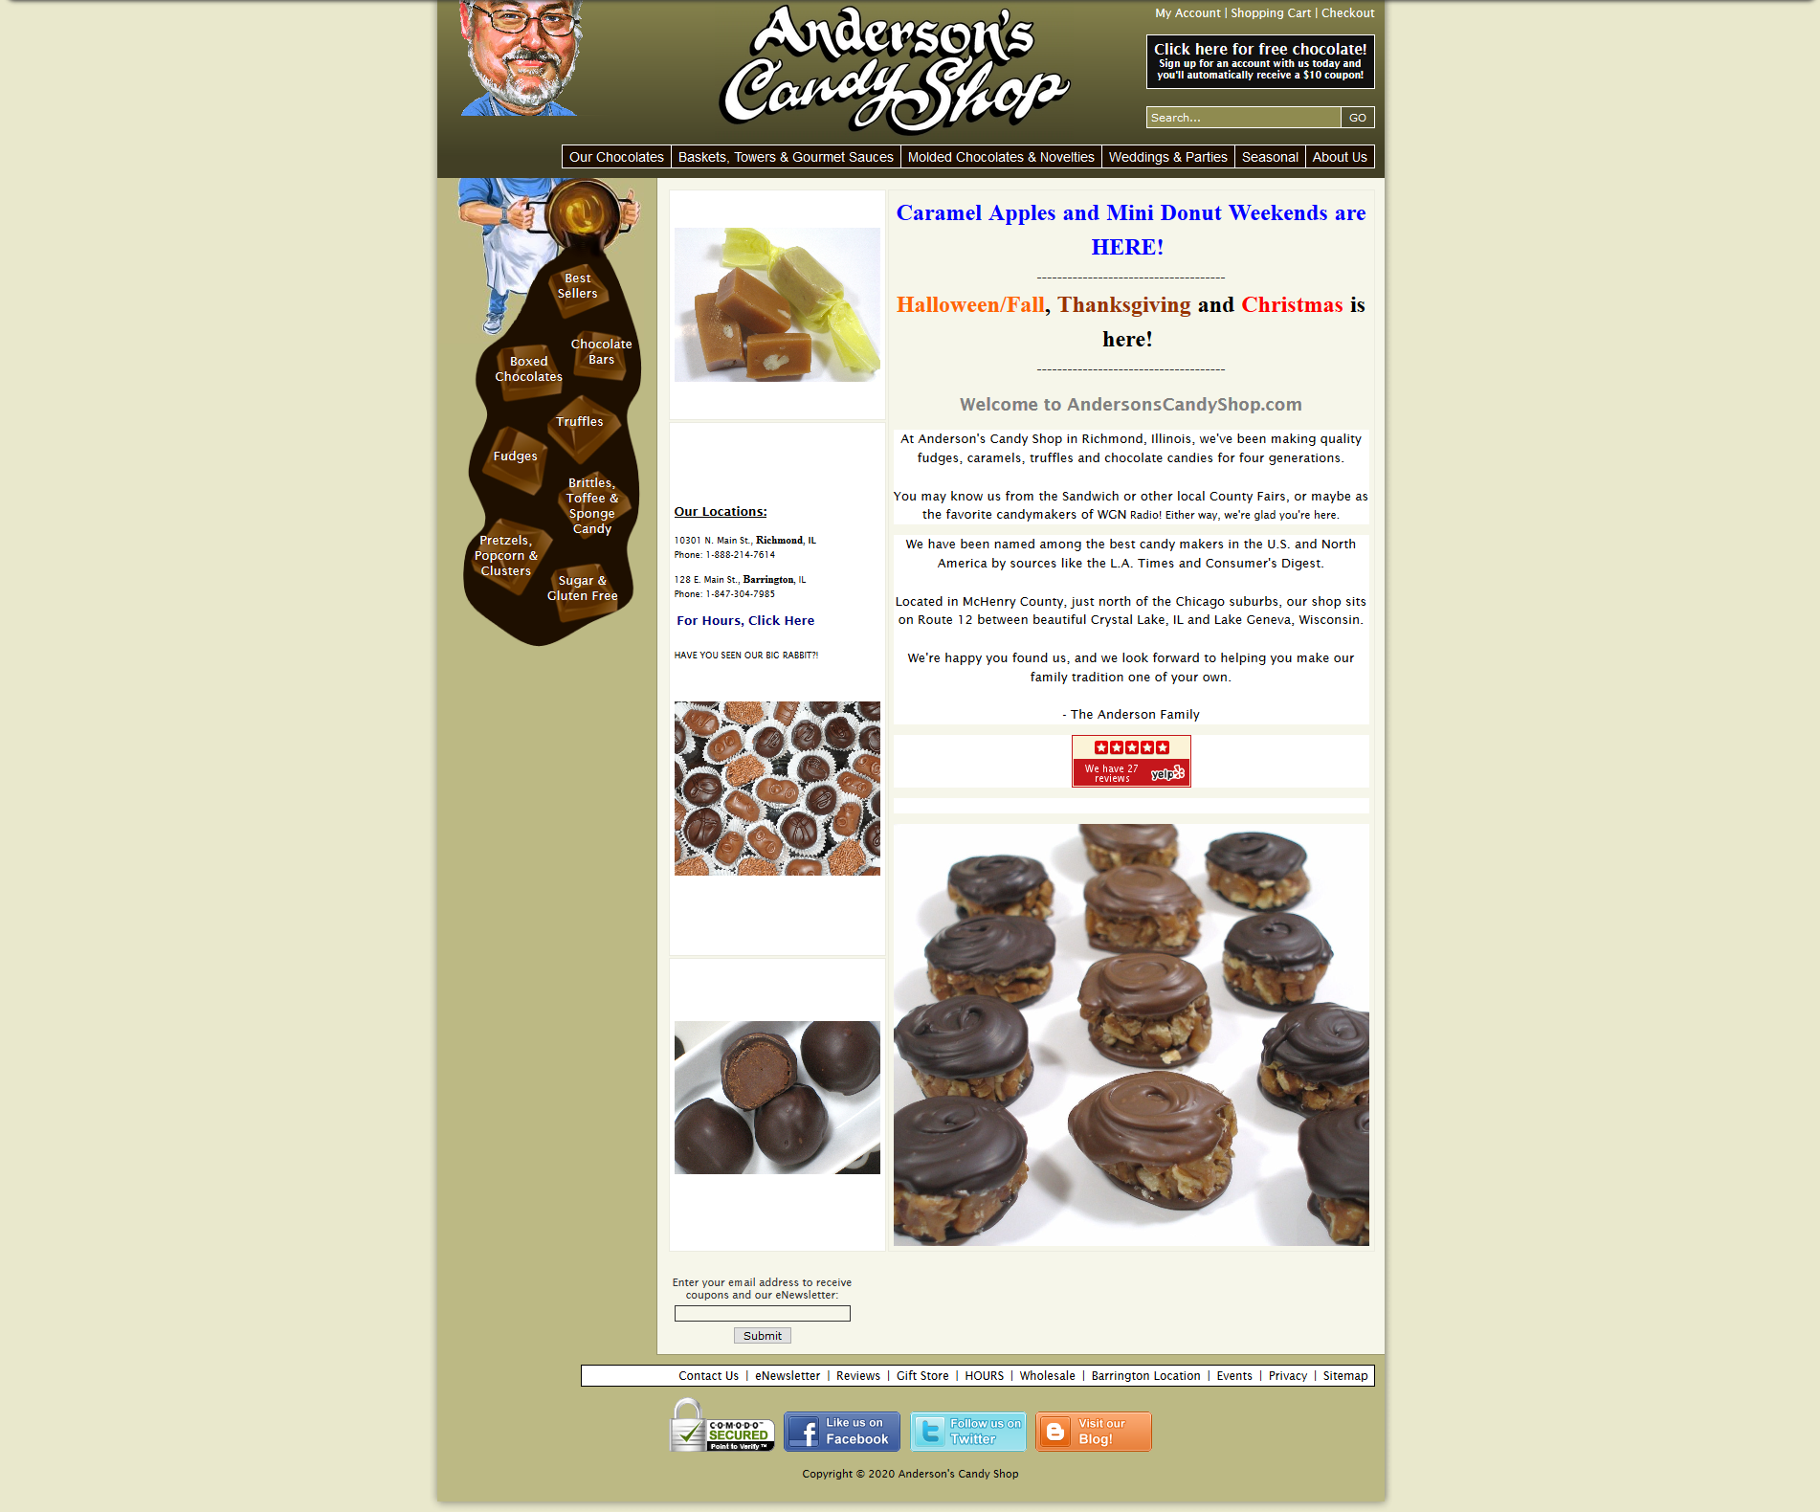
Usability and Testing – Anderson’s Candy Shop
What is Anderson’s Candy shop?
How was this website found?
Why choose to redesign it?

Slide 4
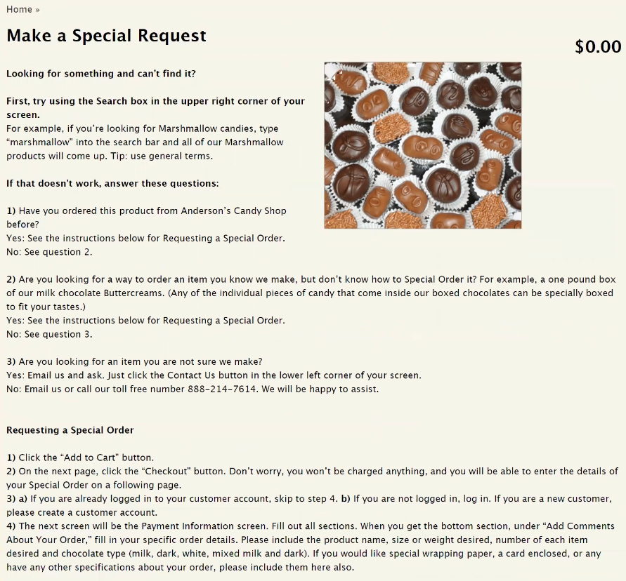
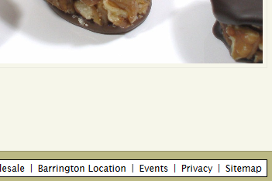
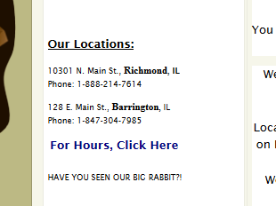
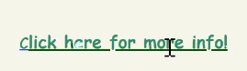
Usability and Testing – Phase I
User Goals Tested:
1. Find the page that shows hours and location of a store
2. Order a special request
3. Find more information about the candy shop’s events

Slide 5
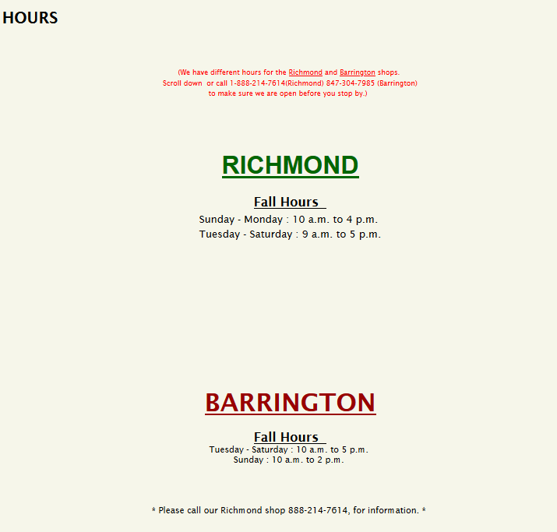
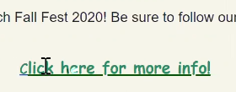
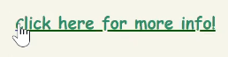
Usability and Testing – Phase I Other findings
Usability and Accessibility
Inconsistent font use
Some text is really big or super small
Too many different font colors
Links not formatted correctly

Slide 6
Usability and Testing – Phase I Other findings
Design/Layout & Images
Poor structured layout
Content and images on random places
Inefficient use of space
Mobile/tablet version is same as desktop
Anderson’s image breaks sometimes
Disorderly chocolate menu

Slide 7
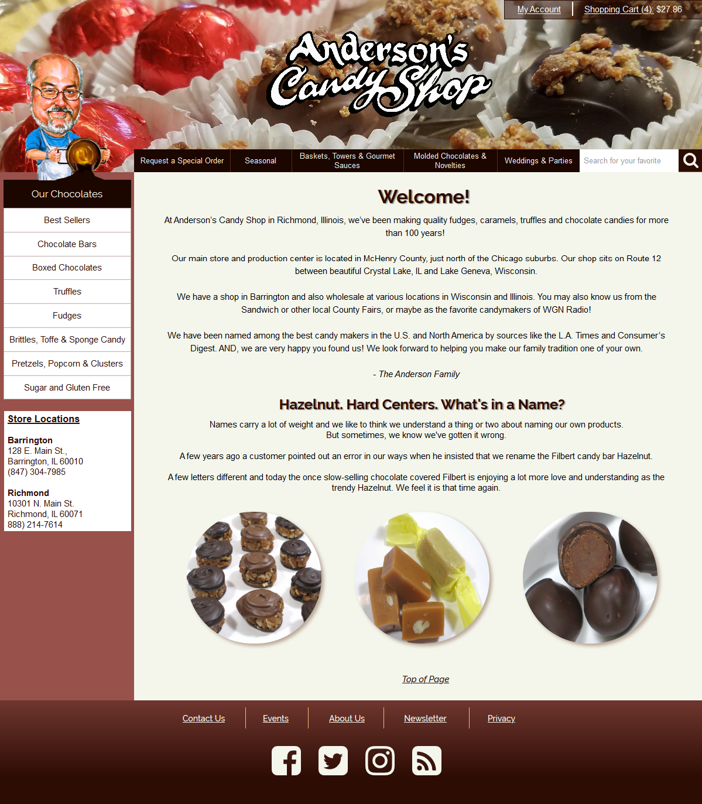

Slide 8
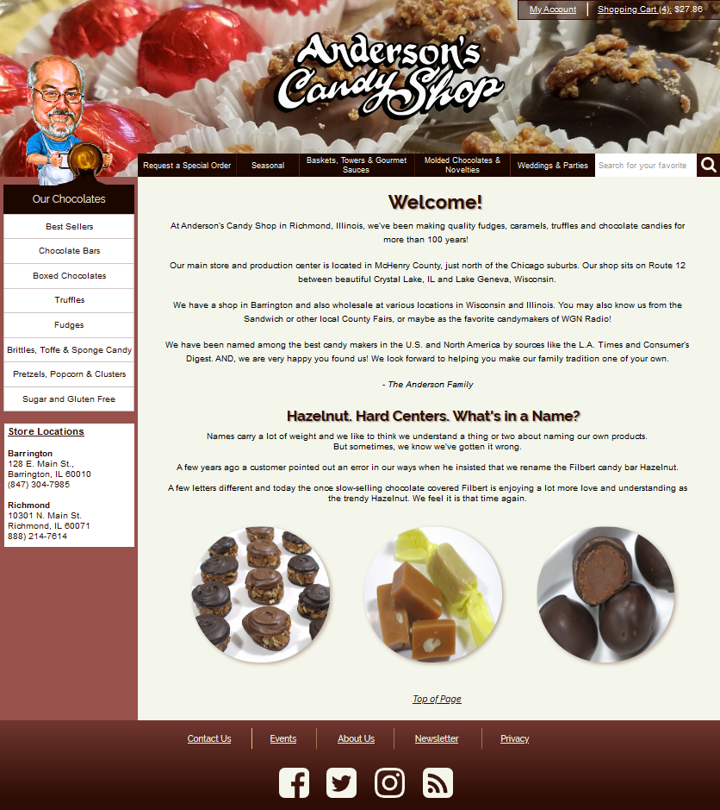
Usability and Testing – Phase II Redesign & Development
Improved overall design
Layout structure is organized
Links are properly formatted
Images work and don’t break

Slide 9
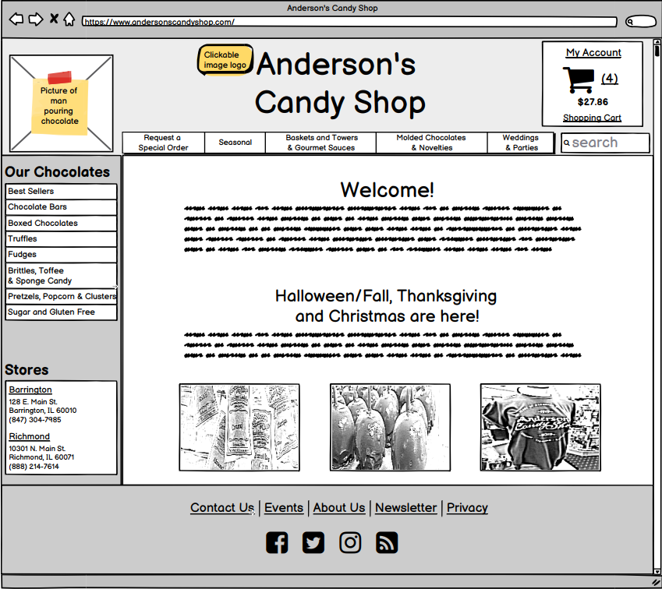
Usability and Testing – Phase II

Slide 10
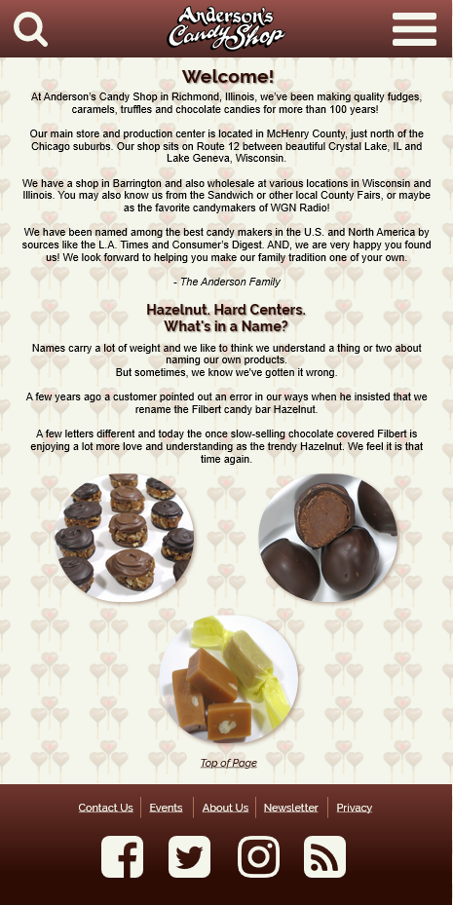

Slide 11
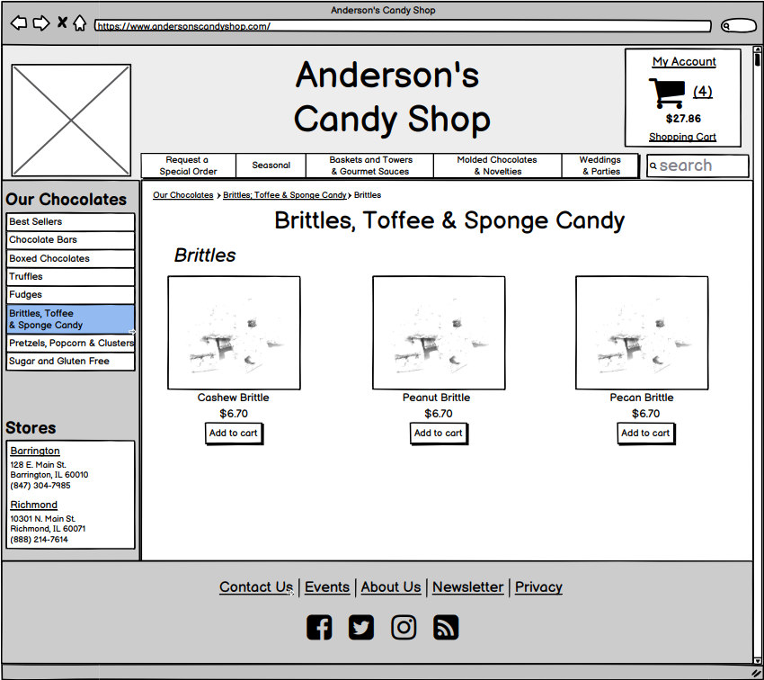
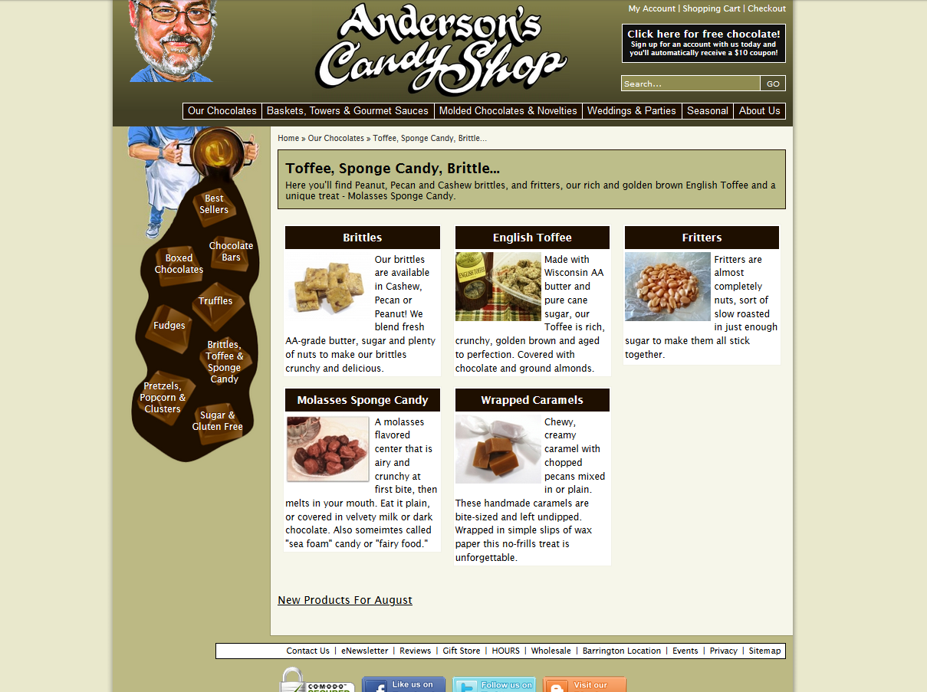
Usability and Testing – Phase II

Slide 12
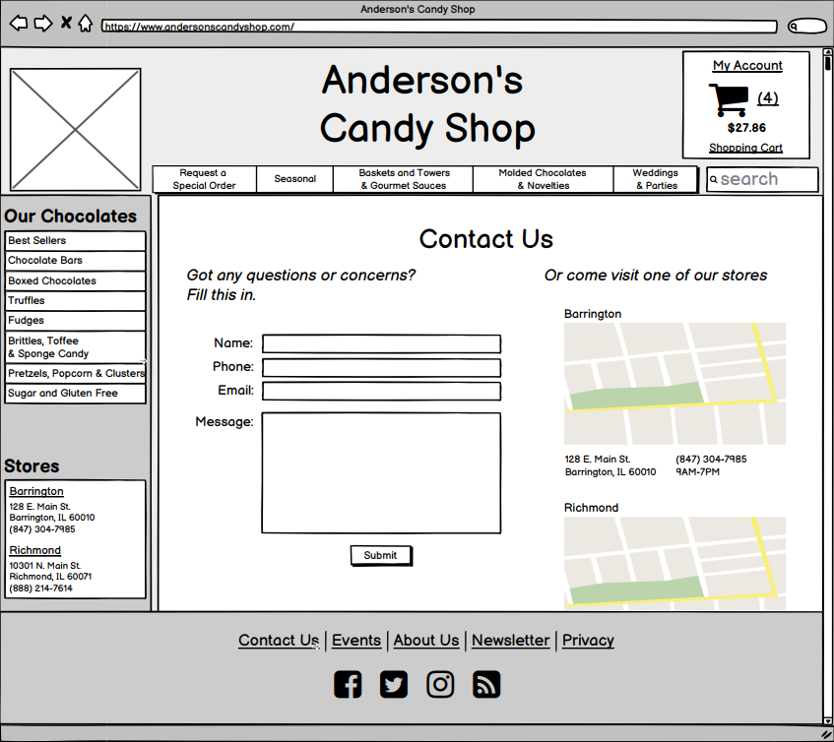
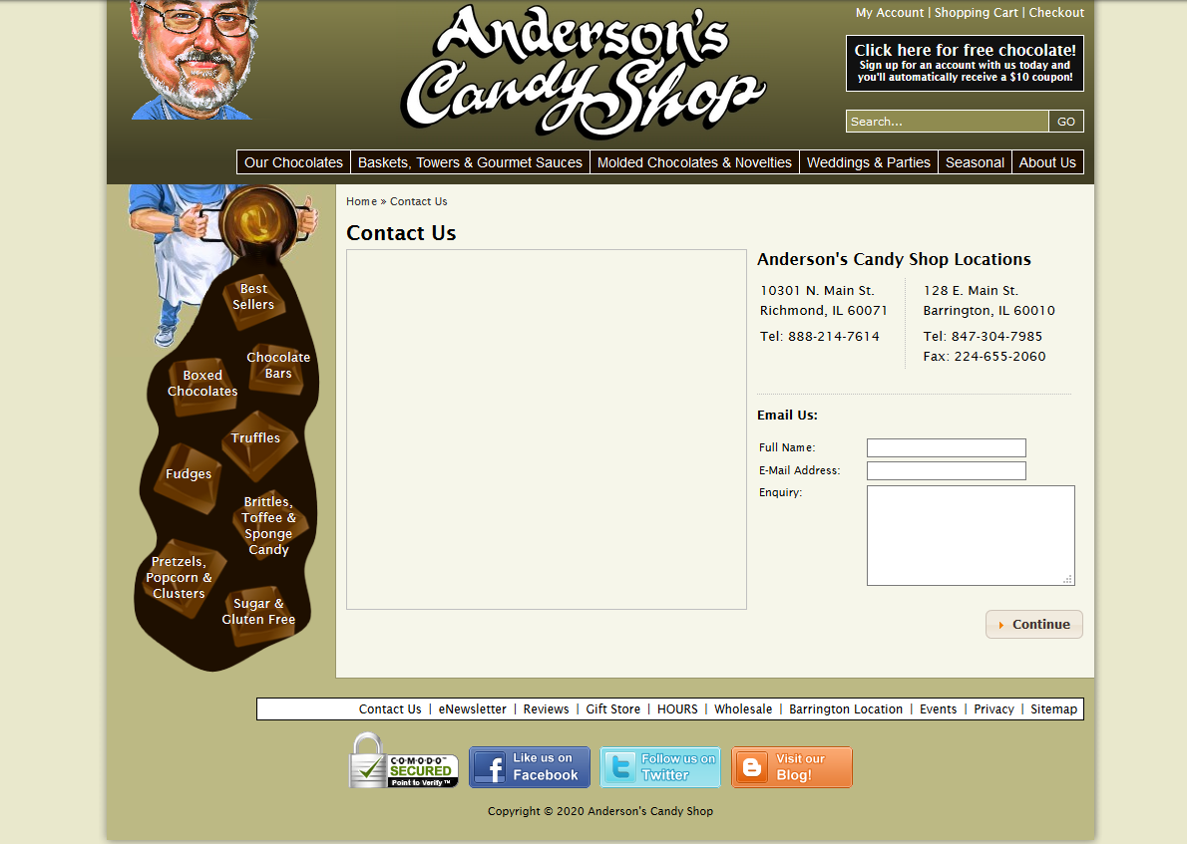
Usability and Testing – Phase II

Slide 13
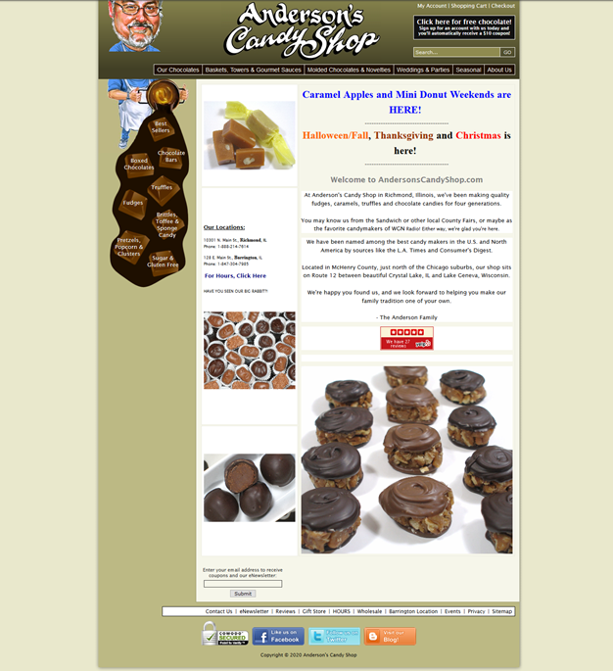

Slide 14
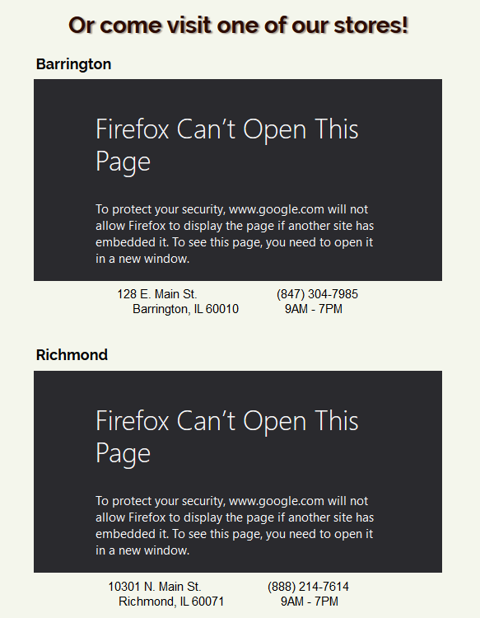
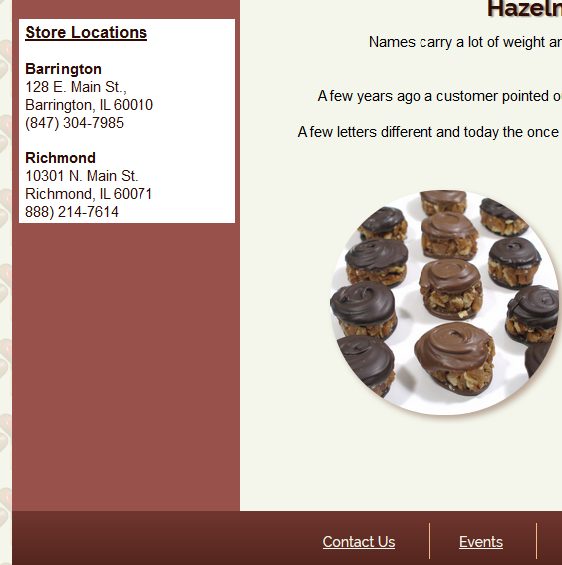
Usability and Testing – Phase II
User Goals Tested:
1. Find the page that shows hours and location of a store
To Improve:
- A link to Locations and Hours
- A link to Events on Homepage

Slide 15
Thank you!

